Slide 1
Unit 3:
Agile Software Development

Slide 2
What is “Agility”?
Effective (rapid and adaptive) response to change (team members, new technology, requirements)
Effective communication in structure and attitudes among all team members, technological and business people, software engineers and managers.
Drawing the customer into the team. Eliminate “us and them” attitude. Planning in an uncertain world has its limits and plan must be flexible.
Organizing a team so that it is in control of the work performed

Slide 3
What is “Agility”?
Eliminate all but the most essential work products and keep them lean.
Emphasize an incremental delivery strategy as opposed to intermediate products that gets working software to the customer as rapidly as feasible.
Rapid, incremental delivery of software
The development guidelines stress delivery over analysis and design although these activates are not discouraged, and active and continuous communication between developers and customers.

Slide 4
Why “Agility” important?
The modern business environment is fast-paced and ever-changing.
It represents a reasonable alternative to conventional software engineering for certain classes of software projects.
It has been demonstrated to deliver successful systems quickly.

Slide 5
An Agile Process
Is driven by customer descriptions of what is required (scenarios).
Some assumptions:
  Recognizes that plans are short-lived (some requirements will persist, some will change. Customer priorities will change)
  Develops software iteratively with a heavy emphasis on construction activities (design and construction are interleaved, hard to say how much design is necessary before construction. Design models are proven as they are created. )
  Analysis, design, construction and testing are not predictable.

Slide 6
An Agile Process
Thus has to Adapt as changes occur due to unpredictability
Delivers multiple ‘software increments’, deliver an operational prototype or portion of an OS to collect customer feedback for adaption.

Slide 7
Agility Principles
Our highest priority is to satisfy the customer through early and continuous delivery of valuable software.
Welcome changing requirements, even late in development. Agile processes harness change for the customer's competitive advantage.
Deliver working software frequently, from a couple of weeks to a couple of months, with a preference to the shorter timescale.
Business people and developers must work together daily throughout the project.
Build projects around motivated individuals. Give them the environment and support they need, and trust them to get the job done.
The most efficient and effective method of conveying information to and within a development team is face–to–face conversation

Slide 8
Agility Principles
Working software is the primary measure of progress.
Agile processes promote sustainable development. The sponsors, developers, and users should be able to maintain a constant pace indefinitely.
Continuous attention to technical excellence and good design enhances agility.
Simplicity – the art of maximizing the amount of work not done – is essential.
The best architectures, requirements, and designs emerge from self–organizing teams.
At regular intervals, the team reflects on how to become more effective, then tunes and adjusts its behavior accordingly.

Slide 9
Agile Methods
The heavyweight, plan-driven development approach is applied to small and medium-sized business systems, the overhead involved is so large that it dominates the software development process.
More time is spent on how the system should be developed than on program development and testing.
As the system requirements change, rework is essential and, in principle at least, the specification and design has to change with the program.

Slide 10
Agile Methods
Dissatisfaction with these heavyweight approaches to software engineering led a number of software developers in the 1990s to propose new ‘agile methods’.
These allowed the development team to focus on the software itself rather than on its design and documentation.
Agile methods universally rely on an incremental approach to software specification, development, and delivery.
They are best suited to application development where the system requirements usually change rapidly during the development process.

Slide 11
Agile Methods
They are intended to deliver working software quickly to customers, who can then propose new and changed requirements to be included in later iterations of the system.
They aim to cut down on process bureaucracy by avoiding work that has dubious long-term value and eliminating documentation that will probably never be used.

Slide 12
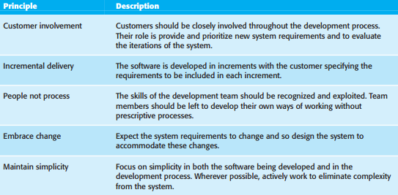
Agile Methods
However, they share a set of principles, based on the agile manifesto, and so have much in common.

Slide 13
Agile Methods
In practice, the principles underlying agile methods are sometimes difficult to realize:
Although the idea of customer involvement in the development process is an attractive one, its success depends on having a customer who is willing and able to spend time with the development team and who can represent all system stakeholders. Frequently, the customer representatives are subject to other pressures and cannot take full part in the software development.
Individual team members may not have suitable personalities for the intense involvement that is typical of agile methods, and therefore not interact well with other team members.
Prioritizing changes can be extremely difficult, especially in systems for which there are many stakeholders. Typically, each stakeholder gives different priorities to different changes.

Slide 14
Agile Methods
In practice, the principles underlying agile methods are sometimes difficult to realize:
Maintaining simplicity requires extra work. Under pressure from delivery schedules, the team members may not have time to carry out desirable system simplifications.
Many organizations, especially large companies, have spent years changing their culture so that processes are defined and followed. It is difficult for them to move to a working model in which processes are informal and defined by development teams.

Slide 15
Limitation of Agile Methods
Many agile methods collect requirements informally and incrementally and do not create a coherent requirements document. In this respect, the use of agile methods is likely to make subsequent system maintenance more difficult and expensive.

Slide 16
Limitation of Agile Methods
The main difficulty after software delivery is likely to be keeping customers involved in the process. Although a customer may be able to justify the fulltime involvement of a representative during system development, this is less likely during maintenance where changes are not continuous. Customer representatives are likely to lose interest in the system.

Slide 17
Limitation of Agile Methods
The other problem that is likely to arise is maintaining continuity of the development team. Agile methods rely on team members understanding aspects of the system without having to consult documentation.
If an agile development team is broken up, then this implicit knowledge is lost and it is difficult for new team members to build up the same understanding of the system and its components.

Slide 18
Plan-driven and agile development
Agile approaches to software development consider design and implementation to be the central activities in the software process. They incorporate other activities, such as requirements elicitation and testing, into design and implementation.
A plan-driven approach to software engineering identifies separate stages in the software process with outputs associated with each stage. The outputs from one stage are used as a basis for planning the following process activity.

Slide 19
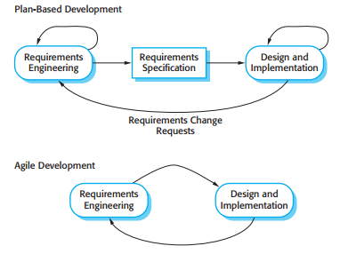
Plan-driven and agile development
Plan-driven and agile specification

Slide 20
Plan-driven and agile development
In a plan-driven approach, iteration occurs within activities with formal documents used to communicate between stages of the process. For example, the requirements will evolve and, ultimately, a requirements specification will be produced. This is then an input to the design and implementation process.
In an agile approach, iteration occurs across activities. Therefore, the requirements and the design are developed together, rather than separately.

Slide 21
Plan-driven and agile development
A plan-driven software process can support incremental development and delivery. It is perfectly feasible to allocate requirements and plan the design and development phase as a series of increments.
An agile process is not inevitably code-focused and it may produce some design documentation. The agile development team may decide to include a documentation ‘spike’, where, instead of producing a new version of a system, the team produce system documentation

Slide 22
Plan-driven and agile development
Most software projects include practices from plan-driven and agile approaches.
To decide on the balance between a plan-based and an agile approach, you have to answer a range of technical, human, and organizational questions:

Slide 23
Plan-driven and agile development
Questions are
Is it important to have a very detailed specification and design before moving to implementation?
If so, you probably need to use a plan-driven approach.
Is an incremental delivery strategy, where you deliver the software to customers and get rapid feedback from them, realistic?
If so, consider using agile methods.
How large is the system that is being developed?
Agile methods are most effective when the system can be developed with a small co-located team who can communicate informally. This may not be possible for large systems that require larger development teams so a plan- driven approach may have to be used.

Slide 24
Plan-driven and agile development
Questions are
4. What type of system is being developed?
Systems that require a lot of analysis before implementation usually need a fairly detailed design to carry out this analysis. A plan driven approach may be best In those circumstances
5. What is the expected system lifetime?
Long-lifetime systems may require more design documentation to communicate the original intentions of the system developers to the support team. However, supporters of agile methods rightly argue that documentation is frequently not kept up to date and it is not of much use for long-term system maintenance.

Slide 25
Plan-driven and agile development
Questions are
6. What technologies are available to support system development?
Agile methods often rely on good tools to keep track of an evolving design. If you are developing a system using an IDE that does not have good tools for program visualization and analysis, then more design documentation may be required.
How is the development team organized?
If the development team is distributed or if part of the development is being outsourced, then you may need to develop design documents to communicate across the development teams. You may need to plan in advance what these are.

Slide 26
Plan-driven and agile development
Questions are
8. Are there cultural issues that may affect the system development?
Traditional engineering organizations have a culture of plan-based development, as this is the norm in engineering. This usually requires extensive design documentation, rather than the informal knowledge used in agile processes.
9. How good are the designers and programmers in the development team?
It is sometimes argued that agile methods require higher skill levels than plan-based approaches in which programmers simply translate a detailed design into code. If you have a team with relatively low skill levels, you may need to use the best people to develop the design, with others responsible for programming

Slide 27
Plan-driven and agile development
Questions are
10. Is the system subject to external regulation?
If a system has to be approved by an external regulator then you will probably be required to produce detailed documentation as part of the system safety case.

Slide 28
Extreme programming
Extreme programming (XP) is perhaps the best known and most widely used of the agile methods.
Named by Beck (2004) because the approach was developed by pushing recognized good practice, such as iterative development, to ‘extreme’ levels.

Slide 29
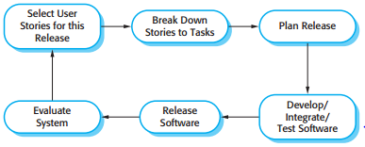
Extreme programming
The extreme programming release cycle

Slide 30
Extreme programming
In extreme programming, requirements are expressed as scenarios (called user stories), which are implemented directly as a series of tasks.
Programmers work in pairs and develop tests for each task before writing the code. All tests must be successfully executed when new code is integrated into the system.
There is a short time gap between releases of the system.

Slide 31
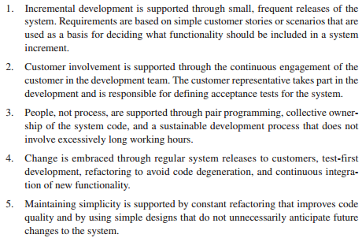
Extreme programming
Extreme programming involves a number of practices which reflect the principles of agile methods:

Slide 32
Extreme programming
In an XP process, customers are intimately involved in specifying and prioritizing system requirements.
The requirements are not specified as lists of required system functions.
Rather, the system customer is part of the development team and discusses scenarios with other team members.
Together, they develop a ‘story card’ that encapsulates the customer needs.
The development team then aims to implement that scenario in a future release of the software.

Slide 33
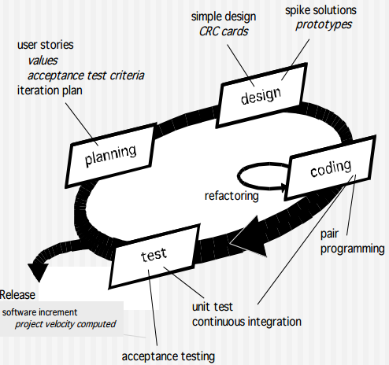
Extreme programming

Slide 34
Extreme programming
The most widely used agile process, originally proposed by Kent Beck in 2004. It uses an object-oriented approach.

Slide 35
Extreme programming
XP Planning
Begins with the listening, leads to creation of “user stories” that describes required output, features, and functionality. Customer assigns a value(i.e., a priority) to each story.
Agile team assesses each story and assigns a cost (development weeks. If more than 3 weeks, customer asked to split into smaller stories)
Working together, stories are grouped for a deliverable increment next release.

Slide 36
Extreme programming
XP Planning
A commitment (stories to be included, delivery date and other project matters) is made.
Three ways:
  Either all stories will be implemented in a few weeks,
  High priority stories first, or
  The riskiest stories will be implemented first.
  After the first increment “project velocity”, namely number of stories implemented during the first release is used to help define subsequent delivery dates for other increments. Customers can add stories, delete existing stories, change values of an existing story, split stories as development work proceeds.

Slide 37
Extreme programming
XP Design (occurs both before and after coding as refactoring is encouraged)
Follows the KIS principle (keep it simple) Nothing more nothing less than the story.
Encourage the use of CRC (class-responsibility-collaborator) cards in an object-oriented context. The only design work product of XP. They identify and organize the classes that are relevant to the current software increment.
For difficult design problems, suggests the creation of “spike solutions”—a design prototype for that portion is implemented and evaluated.
Encourages “refactoring”—an iterative refinement of the internal program design. Does not alter the external behavior yet improve the internal structure. Minimize chances of bugs. More efficient, easy to read.

Slide 38
Extreme programming
XP Coding
Recommends the construction of a unit test for a story before coding commences. So implementer can focus on what must be implemented to pass the test.
Encourages “pair programming”. Two people work together at one workstation. Real time problem solving, real time review for quality assurance. Take slightly different roles.

Slide 39
Extreme programming
XP Testing
All unit tests are executed daily and ideally should be automated. Regression tests are conducted to test current and previous components.
“Acceptance tests” are defined by the customer and executed to assess customer visible functionality

Slide 40
Pair Programming
Another innovative practice that has been introduced in XP is that programmers work in pairs to develop the software. They actually sit together at the same workstation to develop the software.
However, the same pairs do not always program together. Rather, pairs are created dynamically so that all team members work with each other during the development process.

Slide 41
Pair Programming
The use of pair programming has a number of advantages:
It supports the idea of collective ownership and responsibility for the system. This reflects Weinberg’s (1971) idea of egoless programming where the software is owned by the team as a whole and individuals are not held responsible for problems with the code. Instead, the team has collective responsibility for resolving these problems.

Slide 42
Pair Programming
The use of pair programming has a number of advantages:
It acts as an informal review process because each line of code is looked at by at least two people. Code inspections and reviews are very successful in discovering a high percentage of software errors. However, they are time consuming to organize and, typically, introduce delays into the development process. Although pair programming is a less formal process that probably doesn’t find as many errors as code inspections, it is a much cheaper inspection process than formal program inspections.

Slide 43
Pair Programming
The use of pair programming has a number of advantages:
It helps support refactoring, which is a process of software improvement. The pair programming and collective ownership are used, others benefit immediately from the refactoring so they are likely to support the process.
(The difficulty of implementing this in a normal development environment is that effort in refactoring is expended for long- term benefit. An individual who practices refactoring may be judged to be less efficient than one who simply carries on developing code.)

Slide 44
Agile Project Management
Agile development has to be managed so that the best use is made of the time and resources available to the team.
This requires a different approach to project management, which is adapted to incremental development and the particular strengths of agile methods.
The Scrum approach is a general agile method but its focus is on managing iterative development rather than specific technical approaches to agile software engineering.
Scrum, as originally designed, was intended for use with co-located teams where all team members could get together every day in stand-up meetings.

Slide 45
Agile Project Management
The idea behind Scrum is that the whole team should be empowered to make decisions so the term ‘project manager’, has been deliberately avoided.
‘Scrum master’ is a facilitator who arranges daily meetings, tracks the backlog of work to be done, records decisions, measures progress against the backlog, and communicates with customers and management outside of the team.
The whole team attends the daily meetings, which are sometimes ‘stand-up’ meetings to keep them short and focused.
Everyone on the team knows what is going on and, if problems arise, can replan short-term work to cope with them. Everyone participates in this short-term planning—there is no top down direction from the Scrum master.

Slide 46
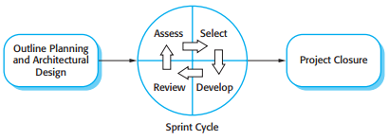
Agile Project Management
Scrum management process.

Slide 47
Agile Project Management
Scrum does not prescribe the use of programming practices such as pair programming and test-first development.
It can therefore be used with more technical agile approaches, such as XP, to provide a management framework for the project.

Slide 48
Agile Project Management
Scrum has three phases:
1st Phase
An outline planning phase where you establish the general objectives for the project and design the software architecture.

Slide 49
Agile Project Management
Scrum has three phases:
2nd Phase
Sprint Cycle, where each cycle develops an increment of the system.
The innovative feature of Scrum is its central phase, namely the sprint cycles.
A Scrum sprint is a planning unit in which the work to be done is assessed, features are selected for development, and the software is implemented.
At the end of a sprint, the completed functionality is delivered to stakeholders.

Slide 50
Agile Project Management
Scrum has three phases:
3rd Phase
The project closure phase wraps up the project, completes required documentation such as system help frames and user manuals, and assesses the lessons learned from the project

Slide 51
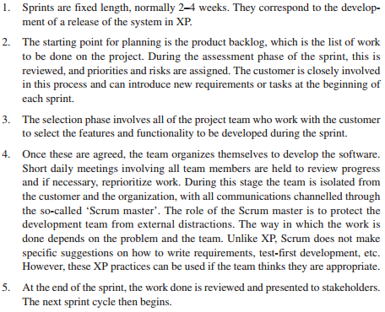
Agile Project Management
Key Characteristics of Sprint

Slide 52
Scaling Agile Methods
Agile methods were developed for use by small programming teams who could work together in the same room and communicate informally.
Agile methods have therefore been mostly used for the development of small and medium-sized systems.
The need for faster delivery of software, which is more suited to customer needs, also applies to larger systems.
Consequently, there has been a great deal of interest in scaling agile methods to cope with larger systems, developed by large organizations.

Slide 53
Scaling Agile Methods
There are two perspectives on the scaling of agile methods:
A scaling up perspective, which is concerned with using these methods for developing large software systems that cannot be developed by a small team.
A scaling out perspective, which is concerned with how agile methods can be introduced across a large organization with many years of software development experience.

Slide 54
Scaling Agile Methods
Agile methods have to be adapted to cope with large systems engineering.
The fundamentals of agile methods:
flexible planning
frequent system releases
continuous integration
test driven development
good team communications.

Slide 55
Scaling Agile Methods
The critical adaptations that have to be introduced for large system engineering are as follows:
For large systems development, it is not possible to focus only on the code of the system.
You need to do more up-front design and system documentation.
The software architecture has to be designed and there has to be
documentation produced to describe critical aspects of the
system, such as database schemas, the work breakdown across
teams, etc.

Slide 56
Scaling Agile Methods
The critical adaptations that have to be introduced for large system engineering are as follows:
2. Cross-team communication mechanisms have to be designed and used. This should involve regular phone and video conferences between team members and frequent, short electronic meetings where teams update each other on progress.

Slide 57
Scaling Agile Methods
The critical adaptations that have to be introduced for large system engineering are as follows:
3. Continuous integration, where the whole system is built every time any developer checks in a change, is practically impossible when several separate programs have to be integrated to create the system. However, it is essential to maintain frequent system builds and regular releases of the system. This may mean that new configuration management tools that support multi-team software development have to be introduced.

Slide 58
Scaling Agile Methods
It is difficult to introduce agile methods into large companies for a number of reasons:
Project managers who do not have experience of agile methods may be reluctant to accept the risk of a new approach, as they do not know how this will affect their particular projects.
Large organizations often have quality procedures and standards that all projects are expected to follow and, because of their bureaucratic nature, these are likely to be incompatible with agile methods. Sometimes, these are supported by software tools (e.g., requirements management tools) and the use of these tools is mandated for all projects.

Slide 59
Scaling Agile Methods
It is difficult to introduce agile methods into large companies for a number of reasons:
Agile methods seem to work best when team members have a relatively high skill level. However, within large organizations, there are likely to be a wide range of skills and abilities, and people with lower skill levels may not be effective team members in agile processes.
There may be cultural resistance to agile methods, especially in those organizations that have a long history of using conventional systems engineering processes.

